Slide 1
CSE 12 – Basic Data Structures and Object-Oriented Design Lecture 19
Greg Miranda & Paul Cao, Winter 2021
This lecture is being recorded

Slide 2
Announcements
Quiz 19 due Wednesday @ 8am
Survey 8 due Friday @ 11:59pm
PA7 due next Tuesday (3/2) @ 11:59pm
Exam 2- see Piazza post

Slide 3
Topics
Questions on Lecture 19?
Binary Search Trees

Slide 4
Binary Search Tree
A binary tree where the key in each node must be greater than or equal to any key stored in the left sub-tree, and less than or equal to any key stored in the right sub-tree
x
<=x
>=x

Slide 5

BST Find
//Adopted from a generic binary tree
boolean containsHelper(BSTNode currRoot, Integer toFind) {
if (currRoot == null) return false; // first base case
if (currRoot.value.equals(toFind)) //second base case
return true;
return containsHelper(currRoot.left, toFind)
|| containsHelper(currRoot.right, toFind);
}
Can I just use this for BST find?
Yes, it will work just fine.
Yes, but we can probably do better
No, it won’t work for a BST

Slide 6
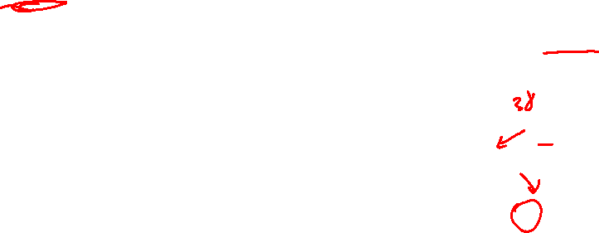
//Adopted from a generic binary tree
boolean findHelper(BSTNode currRoot, Integer toFind) {
if (currRoot == null) return false; // first base case
if (currRoot.value.equals(toFind)) //second base case
return true;
return containsHelper(currRoot.left, toFind)
|| containsHelper(currRoot.right, toFind);
}
FindHelper(root, 38)
root
42
32
65
30
38
//BST version
boolean findHelper(BSTNode curr, Integer value){
if (curr == null) return false;
if (curr.value.equals(value)) return true;
if (curr.value.compareTo(value)<0){ //value is bigger than current node
return findHelper(curr.right, value);
}
else{
return findHelper(curr.left, value);
}
}

Slide 7
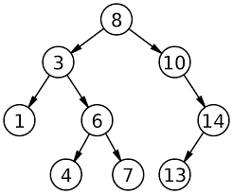
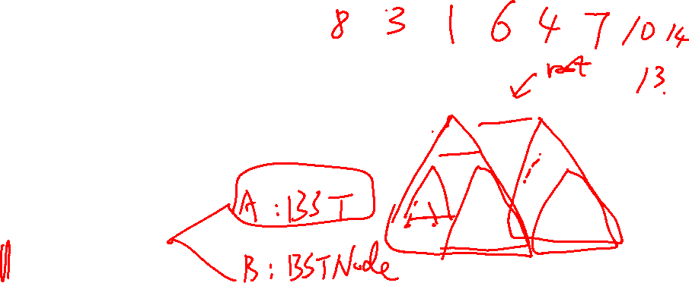
Binary Search Tree
What order does PAE() traverse the tree?
void printAllElements(Node<K, N> n) {
if (n == null ) return;
System.out.println(n.key);
printAllElements(n.left);
printAllElements(n.right);
}
void printAllElement() {
printAllElements(this.root);
}
What’s the post, pre, in-order traversal of this tree?

Slide 8
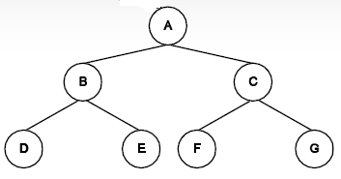

In-order traversal
inorder(node) {
if (node != null){
inorder(node.left)
visit this node
inorder(node.right)
}
}
D B E A F C G
A B D E C F G
A B C D E F G
D E B F G C A
Other

Slide 9

Pre-order traversal
preorder(node) {
if (node != null){
visit this node
preorder(node.left)
preorder(node.right)
}
}
D B E A F C G
A B D E C F G
A B C D E F G
D E B F G C A
Other/none/more

Slide 10

Post-order traversal
postorder(node) {
if (node != null){
postorder(node.left)
postorder(node.right)
visit this node
}
}
D B E A F C G
A B D E C F G
A B C D E F G
D E B F G C A
Other/none/more

Slide 11
The BST and BSTNode Classes
public class BST<E extends Comparable<E>>
{
/** Inner class for the BSTNode */
private class BSTNode {
BSTNode leftChild;
BSTNode rightChild;
BSTNode parent;
E element;
public BSTNode(E elem){
element = elem;
}
}
BSTNode root;
......
}
root
42
32
65
30
38

Slide 12
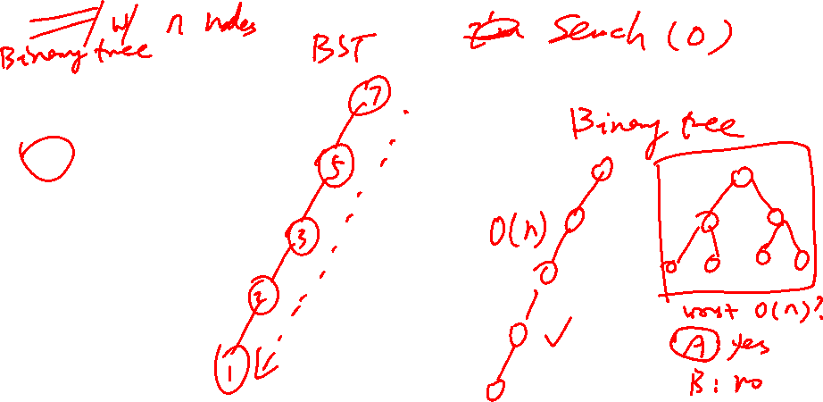
What is the WORST CASE cost for doing find() in a BST?
O(1)
O(log n)
O(n)
O(n log n)
O(n²)

Slide 13
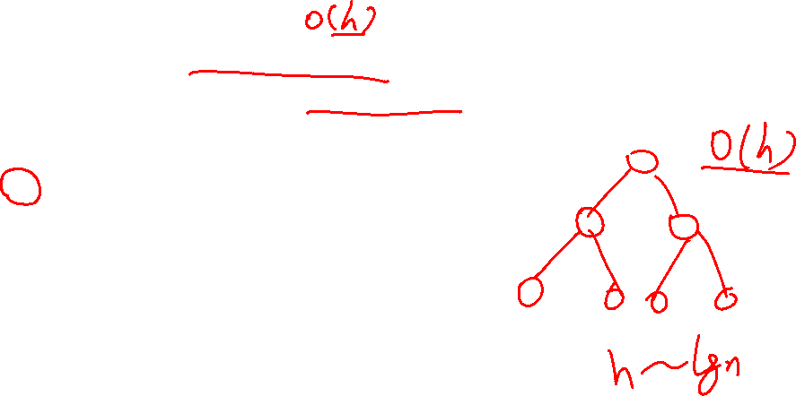
What is the WORST CASE cost for doing find() in a BST if the BST is full/"balanced"?
O(1)
O(log n)
O(n)
O(n log n)
O(n²)

Slide 14
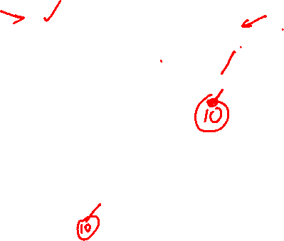
BST Add: With recursion!
Consider the following:
root
root
42
42
add(10)
32
65
add(42)
32
65
30
38
30
38
31
31
root
30
add(10)
31

Slide 15
BST Add: Recursively
boolean add( E toAdd ) {
if (toAdd == null) throw new NullPointerException();
if (root == null) {
root = new BSTNode(toAdd);
}
return addHelper(root, toAdd );
}
boolean addHelper( BSTNode currRoot, E toAdd )
{
…
}
42
32
65
Which of these is/are a base case for addHelper?
currRoot is null
currRoot’s element is equal to toAdd
Both A & B
Neither of these
30
38
31

Slide 16

BST Add: Recursively
boolean add( E toAdd ) {
if (root == null) {
root = new BSTNode(toAdd);
}
return addHelper( root, toAdd );
}
boolean addHelper( BSTNode currRoot, E toAdd )
{
int compare = toAdd.compareTo(currRoot.getElement());
if (compare == 0) {
return false;
}
// Finish the code…
}
42
32
65
30
38

Slide 17
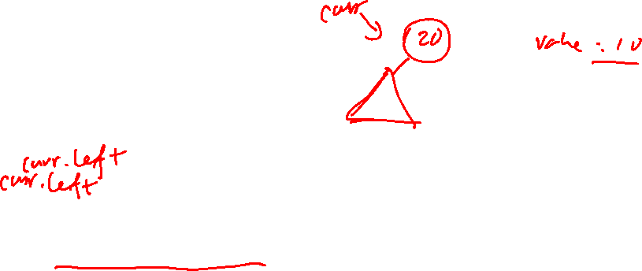
BST Add: Recursively
boolean addHelper(BSTNode curr, Integer value){
int result = curr.value.compareTo(value);
if (result == 0){
return false;
}
if (result > 0){
if (_____________== null){
_____________ = new BSTNode(value);
return true;
}
else{
return _______________________
}
}
else{//Similar idea
}
}
What should I fill in the red blank (they should be the same)
root.left
root.right
curr.left
curr.right
Something else

Slide 18
BST Add: Recursively
boolean addHelper(BSTNode curr, Integer value){
int result = curr.value.compareTo(value);
if (result == 0){
return false;
}
if (result > 0){
if (curr.left == null){
curr.left = new BSTNode(value);
return true;
}
else{
return ________________________;
}
}
else{//Similar idea
}
}
What should I fill in the red blank
addHelper(root.right, value)
addHelper(root.left, value)
addHelper(curr.left, value)
addHelper(curr.right, value)
Something else

Slide 19

How to debug your code
Print out your tree
public String treePrint(){
if (root == null) return "";
return treePrintHelper(root);
}
public String treePrintHelper(BSTNode curr){
if (curr == null) return "";
String temp =__________________;
//make sure you put in curr, curr.left, curr.right
//for easy identification of node relationships
return temp + treePrintHelper(curr.left) + treePrintHelper(curr.right);
}

Slide 20
Remove from a BST
Find the node while keeping track of the parent of the node you are about to visit
Delete the node
1. Node to delete is a leaf node
2. Node to delete only has one child
3. Node to delete has two children
42
32
56
12
35
48
60
6

Slide 21
public void removeHelper(BSTNode curr){
}
42
if (curr.left != null && curr.right != null){
//a node with 2 children
}
if (curr == root){
//root node
}
32
56
12
35
48
60
if (curr.left!= null){
}
else if (curr.right != null){
}
6
if (curr.left == null && curr.right == null){
//leaf node
}

Slide 22
Successor of a Node
42
What is the successor of 32?
35
42
60
6
Something else
32
56
12
35
48
60
6
What is the successor of 12?
32
35
42
48
Something else
Which class is a better fit to have the successor function?
In BSTNode class
In BST class
Either one is fine. It depends on your design

Slide 23
min of a BST
What should I fill in blank A?
root.left == null
root.left != null
curr != null
curr.left != null
Something else
public BSTNode min(BSTNode curr){
if (________A_________){
return curr;
}
else{
return_________B____________;
}
}
What should I fill in blank B?
min(root.left)
min(curr.right)
min(curr.left)
min(curr.left.right)
Something else

Slide 24
Questions on Lecture 19?

